Slide 1


Main project: Bayesian inference with Expectation Maximisation for the characterisation of antibiotic treatment recovery in Cystic Fibrosis
Side project: Estimation of the variability in Cystic
Fibrosis patient’s FEV1 lung function measurements
Master’s thesis of Tristan Trébaol
University of Cambridge
Department of Medicine
Academic hosts
Prof. Andres Floto
Ph.D. Damian Sutcliffe
External Expert
John Winn, Machine Intelligence Group, Microsoft Research
École Polytechnique Fédérale de Lausanne
School of Engineering, School of Computer and Communication Sciences
Supervised by
Prof. Philippe Müllhaupt, School of Engineering
Prof. Martin Jaggi, Machine Learning and Optimization Laboratory
Dr. Mary-Anne Hartley, Machine Learning and Optimization Laboratory
26.08.2021
Notes:
2 points before starting
While reading the report you might have seen typos/bad formulations -> I modified them prior to final upload
1 rule: cut me anytime judged necessary because the goal is to maximise your understanding of my work.

Slide 2
Thesis aim
Introduction
Aim: improve hospital-based monitoring of Cystic Fibrosis
Data: UK CF home monitoring study
Tools: Machine Learning and statistics, EPFL and Microsoft Research
CF expertise: clinicians from the Department of Medicine, University of Cambridge

Slide 3
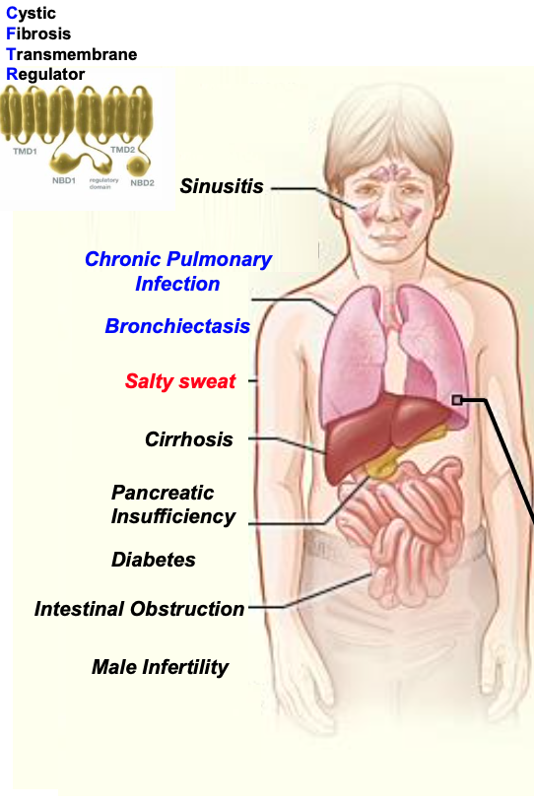
Cystic Fibrosis: pathophysiology
Introduction
90’000 individuals worldwide
Notes:
Most common genetic sickness in the world
Caused by a mutation leading to CFTR protein deficiency which affects multiple organs in the body

Slide 4
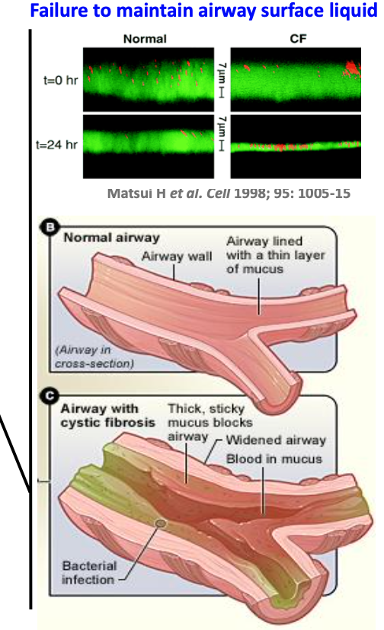
Cystic Fibrosis: pathophysiology
Introduction
90’000 individuals worldwide
Notes:
In particular lungs

Slide 5
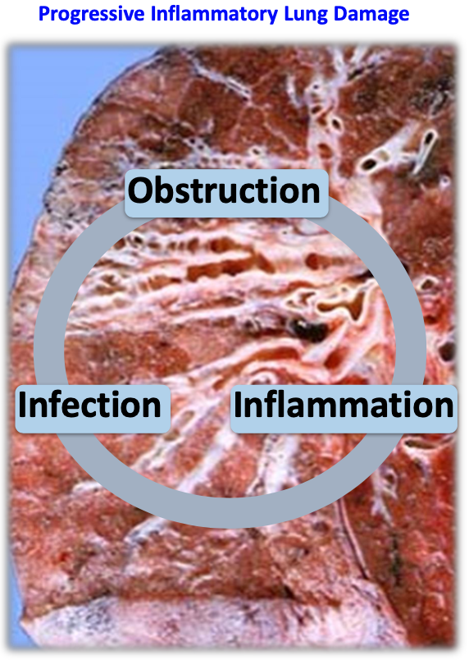
Cystic Fibrosis: pathophysiology
Introduction
90’000 individuals worldwide
Notes:
Most common genetic sickness in the world

Slide 6
Cystic Fibrosis: pathophysiology
Introduction
Acute pulmonary exacerbation
Unsuccessful recovery
or novel bacterial infection
Ineffective immune response
Antibiotic treatment
Symptoms:
Cough
Fatigue
Lung function diminution
Decrease in oxygen saturation
Breathlessness
Increased volume of purulent sputum
Limited life expectancy
Notes:
Downward spiral – infection leading to APE (with symptoms) – ineffective response that requires antibiotic treatment followed by unsuccessful recovery or successful recovery but sooner or later a novel infection

Slide 7
Cystic Fibrosis: pathophysiology
Introduction
Acute pulmonary exacerbation
Unsuccessful recovery
or novel bacterial infection
Ineffective immune response
Antibiotic treatment
Symptoms:
Cough
Fatigue
Lung function diminution
Decrease in oxygen saturation
Breathlessness
Increased volume of purulent sputum
Limited life expectancy
Notes:
Given the impact on life expectancy and wellbeing, it is critical understand the underlying processes.
In literature APE were studied, but there is a very rare focus on recovery. Hence characterise recovery after an antibiotic treatment

Slide 8
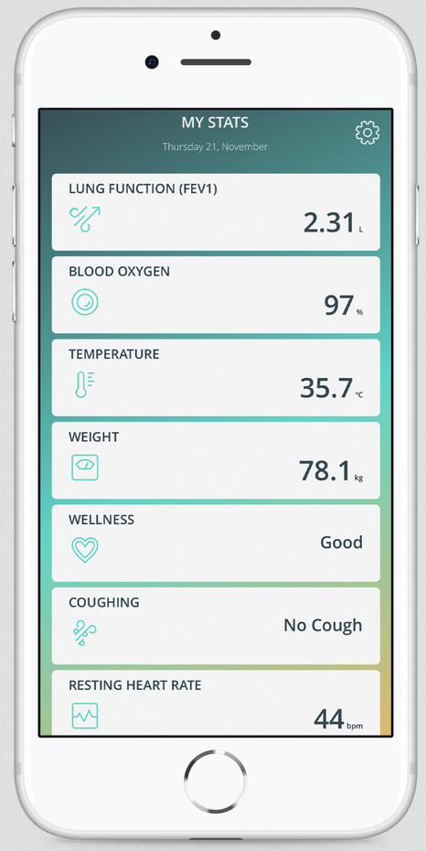
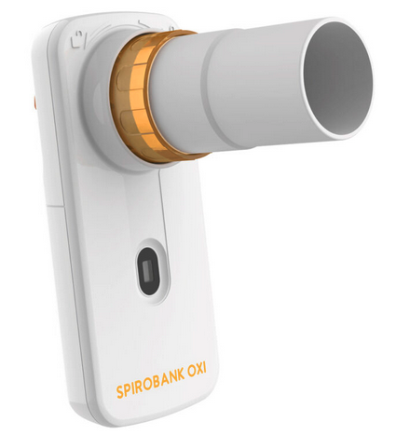

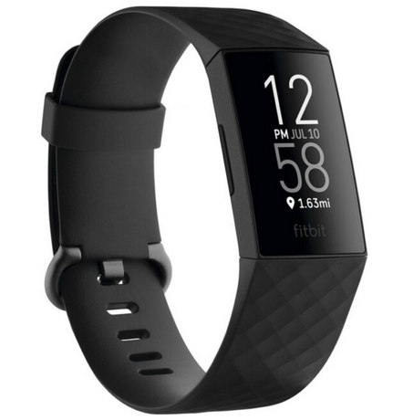
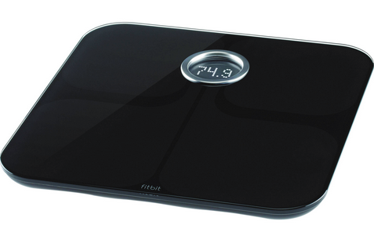
The potential of home monitoring
Introduction
Project Breathe biggest CF data set in the world with daily measurements:
2 hospitals in the UK
> 300 patients
Multidimensional
Automatic recording
> 500k recordings
Ongoing
Spirometer +
Pulse Oximeter:
Lung function (FEV₁, FEF₂₅₇₅, …)
O₂ saturation
Pulse rate
Smartwatch:
Calories
Resting heart rate
Sleep
Self-reported symptom diary:
Wellness
Cough
Temperature
Weight
Notes:
Project Breathe created the biggest data set of CF patients day-to-day physiological measurements in the world.
SLIDE
In comparison there two recent papers on recovery in 2017 with 1 feature, monthly measurements – our data set is much more exciting

Slide 9
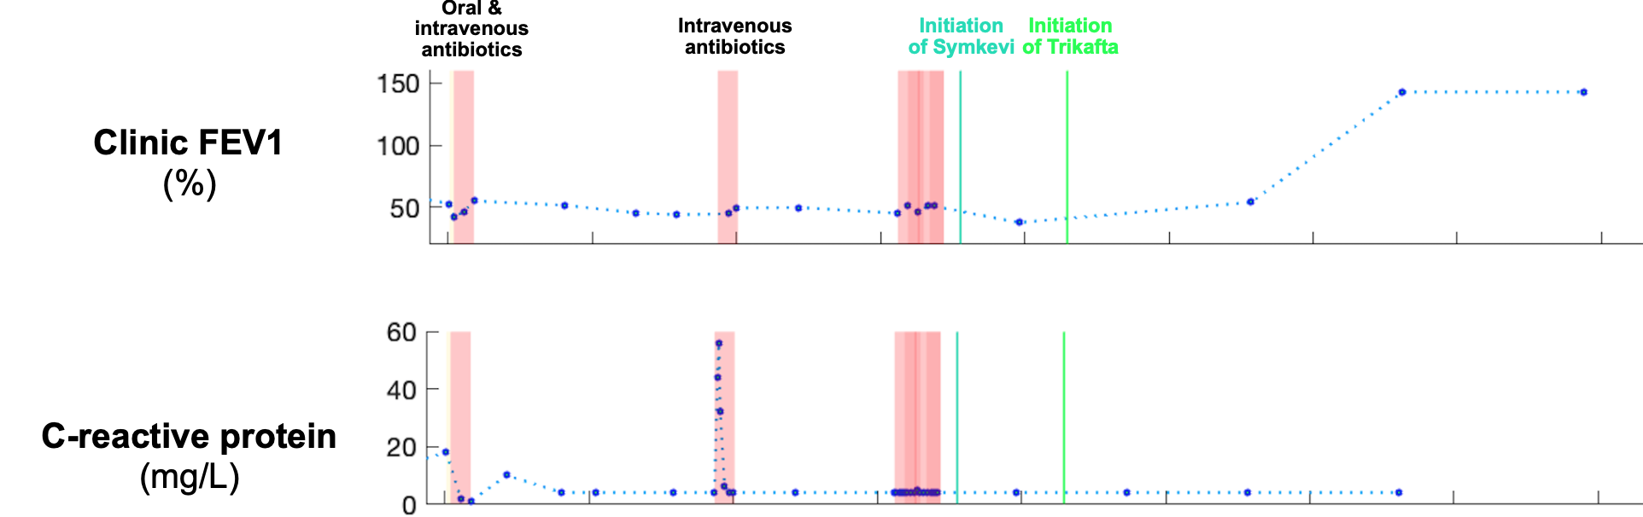
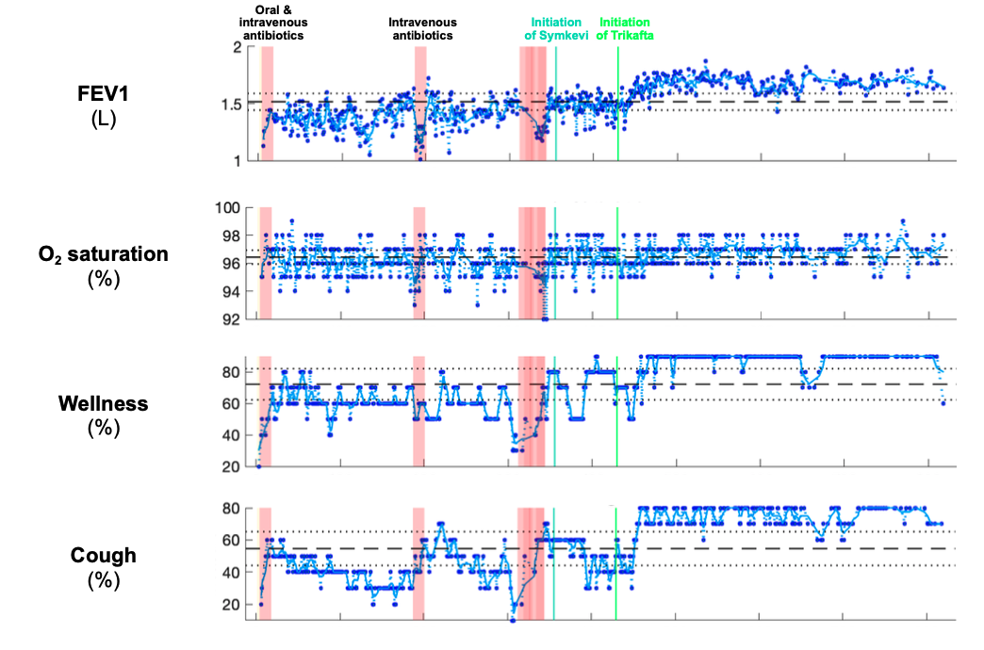
Antibiotic treatments & CFTR modulator therapies
Clinical data:
Bimonthly recordings
Home monitoring data:
Measurements ~3 times
per week
Inverted signals: cough reduction!
Notes:
Antibiotic treatment: drug that acts the symptoms by killing bacterias in the lung
CFTR modulator therapies: drug that acts at the root by restoring the CFTR protein at the disease’s origin

Slide 10
Antibiotic treatments & CFTR modulator therapies
Clinical data:
Bimonthly recordings
Home monitoring data:
Measurements ~3 times
per week
Anecdote about me:
95% FEV₁
Started Trikafta
Now:
better sleeping
0 cough
gained 1h daily treatment
110%
Inverted signals: cough reduction!

Slide 11
Antibiotic treatments & CFTR modulator therapies
Clinical data:
Bimonthly recordings
Home monitoring data:
Measurements ~3 times
per week
Richness => ML
Inverted signals: cough reduction!

Slide 12
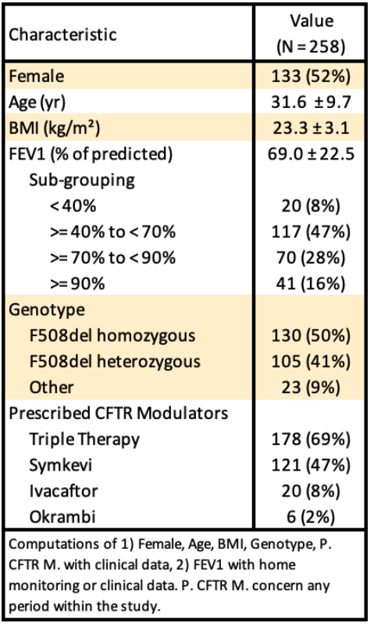
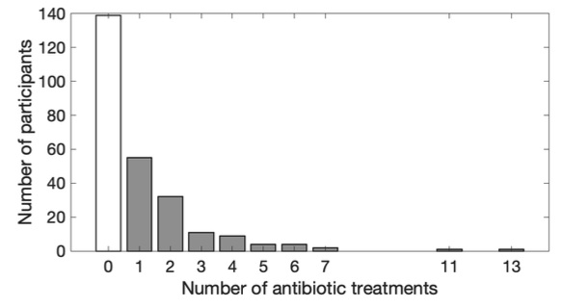
Available data (adult population)
Introduction
Notes:
Representative sample of the CF population in the UK
Great progress in CF care – in the 60s survival was 4 years old– Now most is adult

Slide 13
Objectives
Introduction
Ask clinical questions
How does a recovery look like?
Are there different types of recoveries?
Answer them with Machine Learning
Bayesian inference algorithm
Convergence with expectation maximisation
Provide interpretable results to clinicians
Clinicians feedback:
- Royal Papworth Hospital (UK)
- Hôpital Necker (France)
- Arizona Health Sciences Center (US)
Notes:
How does an recovery or APE look like ?
Are there different types of recovery and APE ?
Questions answered for APEs, based on the mother study of Project Breathe
Questions answered for APEs at the university of cambridge, not for recovery

Slide 14
Alignment model: samples
Material and methods
N = 119 normalised antibiotic interventions
FEV₁
1
FEV₁
2
…
FEV₁
N
D
Antibiotic intervention start
time
Notes:
Important: use the model from Damian, ML model already implemented 1) adapt, 2) formalize the maths
Goal: find the typical profile

Slide 15
Alignment model: alignment
Material and methods
Shifted interventions
N = 119 normalised antibiotic interventions
FEV₁
1
F₁= 0
Alignment
FEV₁
2
F₂
…
…
FEV₁
N
F_{N}
D
D
Antibiotic intervention start
time
Notes:
Align the curves to find consensus of recovery start

Slide 16
Alignment model: averaging
Material and methods
Shifted interventions
N = 119 normalised antibiotic interventions
FEV₁
1
F₁= 0
Alignment
FEV₁
2
F₂
…
Max offset = 15
…
FEV₁
N
F_{N}
D
D=20
Averaging
K=35
Antibiotic intervention start
time
FEV₁
Typical profile
Time (days)
Notes:
Learn a variable F_n to push the data records to the right – until right place on typical profile
Numerical instability: left part and right part -> no measurements

Slide 17
Alignment model: numerical stability
Material and methods
Imputed and and shifted interventions
N = 119 normalised antibiotic interventions
Imputed values
FEV₁
1
F₁= 0
Alignment
Imputed values
FEV₁
2
F₂
…
Max offset = 15
…
FEV₁
N
F_{N}
D
D=20
Averaging
K=35
Antibiotic intervention start
time
FEV₁
Typical profile
Time (days)
Notes:
Handle numerical instability

Slide 18
Alignment model: multidimensionality
Material and methods
Imputed and and shifted interventions
N = 119 normalised antibiotic interventions
Imputed values
FEV₁
1
F₁= 0
Alignment
Imputed values
FEV₁
2
F₂
…
Max offset = 15
…
FEV₁
N
F_{N}
D
D=20
Averaging
K=35
Antibiotic intervention start
time
FEV₁
Typical profile
M dimensions (FEV₁, wellness O₂ saturation, etc) give M typical curves
K-D = 15
Time (days)
Notes:
All of this is done in multidimensions

Slide 19
Model assumptions
Material and methods
For each measure, the recorded values for the period immediately following treatment are a noisy version of a single typical profile.
2. The amount a measured value deviates from this profile is controlled by the position on the profile and is independent from one day to the next.
3. The treatment start can happen anytime between day 1 and the maximum allowed offset (K-D).
K=35
FEV₁
Typical profile
M dimensions (FEV₁, wellness O₂ saturation, etc) give M typical curves
K-D = 15
Time (days)
Notes:
2) Offset + noise is independent from on day to the next

Slide 20
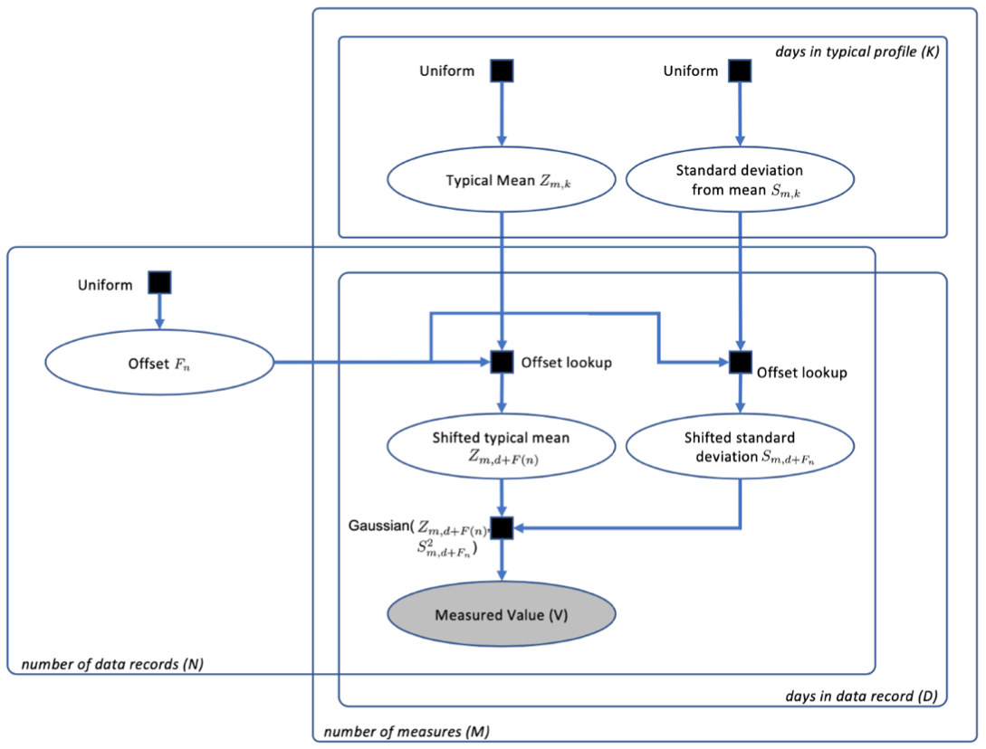
Data generation process
Material and methods
Notes:
Explains how each measurements can be reproduced algorithmically

Slide 21
Machine learning model formulation
Material and methods
Initialisation: P(F_{N}) is uniformly initialised over the offsets’ span [0; K-D-1]
P(F₁)
+
+
+
+
+
1 2 3 4 … K-D
0 1 2 4 … K-D-1

Slide 22
Machine learning model formulation
Material and methods
Initialisation: P(F_{N}) is uniformly initialised over the offsets’ span [0; K-D-1]
no shift
End-state:
max shift
P(F₁)
P(F₁)
+
+
+
+
+
+
+
+
+
+
Time on the typical profile (days)
1 2 3 4 … K-D
1 2 3 4 … K-D
0 1 2 4 … K-D-1
0 1 2 4 … K-D-1
Offsets (days)

Slide 23
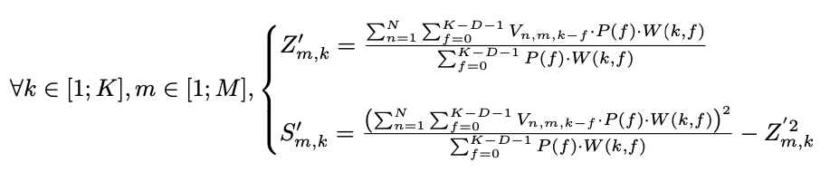
Machine learning model formulation
Material and methods
Initialisation: P(F_{N}) is uniformly initialised over the offsets’ span [0; K-D-1]
no shift
End-state:
max shift
P(F₁)
P(F₁)
+
+
+
+
+
+
+
+
+
+
Time on the typical profile (days)
1 2 3 4 … K-D
1 2 3 4 … K-D
0 1 2 4 … K-D-1
0 1 2 4 … K-D-1
Offsets (days)
Averaging
Notes:
All values of all interventions for all offsets, each time weighted by the probability distribution of the current offset, contribute to the corresponding Z,S of the typical profile. However, we can't compute Z, S directly because at initialisation, P(f) is uniform

Slide 24
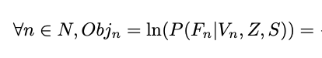
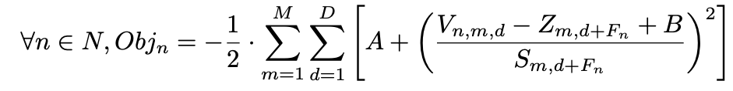
Machine learning model formulation
Material and methods
Initialisation: P(F_{N}) is uniformly initialised over the offsets’ span [0; K-D-1]
no shift
End-state:
max shift
P(F₁)
P(F₁)
+
+
+
+
+
+
+
+
+
+
Time on the typical profile (days)
1 2 3 4 … K-D
1 2 3 4 … K-D
0 1 2 4 … K-D-1
0 1 2 4 … K-D-1
Offsets (days)
Expectation-step:
Update P(F_{n})
Maximisation-step:
Averaging
Notes:
Alignment:
E-step - updates the probability distribution P(Fn) of the offsets, knowing the latent curve
M-step – points on the typical profile are the MLE of the likelihood, knowing P(Fn)
Vertical shift: extension of the model to increase decision making in the offset probability distribution

Slide 25
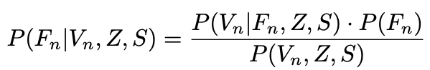
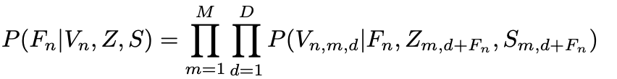
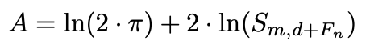
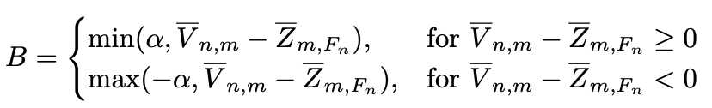
E-step: Bayes theorem
Material and methods
Given a set of measured values V_{n}, Z and S fixed from the previous M-step:
Vertical shift:
Notes:
posterior is proportional to likelihood times prior

Slide 26
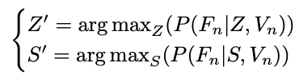
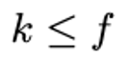
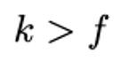
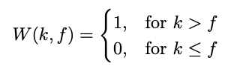
M-step: maximum likelihood estimator Z and S
Material and methods
Given a set of measured values V_{n}, and the offset probability distribution F_{n} fixed from the previous E-step:
Imputed values
Yes/no function:
Time (days)
1 2 3 4 … K
Notes:
Yes/no function: removes all values prior to treatment start – avoids having any data during an exacerbation
Handles numerical instability to the right by accepting

Slide 27
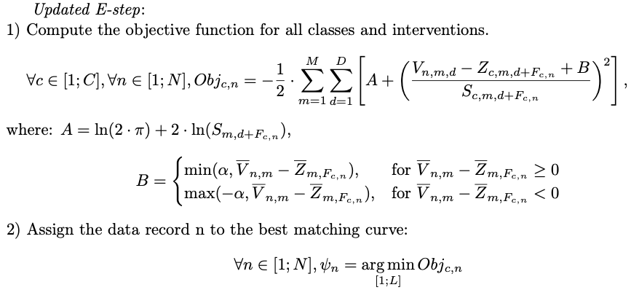
Extension to multiple classes inference
Material and methods
Notes:
Obj for each class
Min obj into phi
One new variable psi that assigns each data record to the best matching class

Slide 28
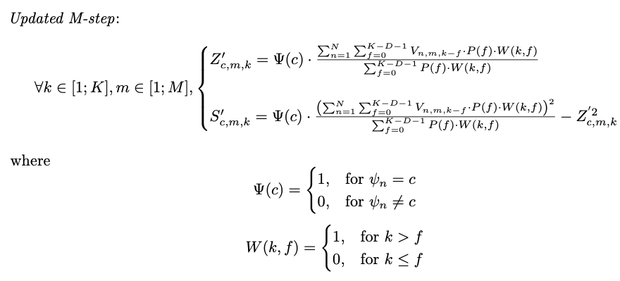
Extension to multiple classes inference
Material and methods
Notes:
Psi uses phi to keep only the data records belonging to current class in Z and S
One new function yes/no function that removes all data records not belonging to the current class

Slide 29
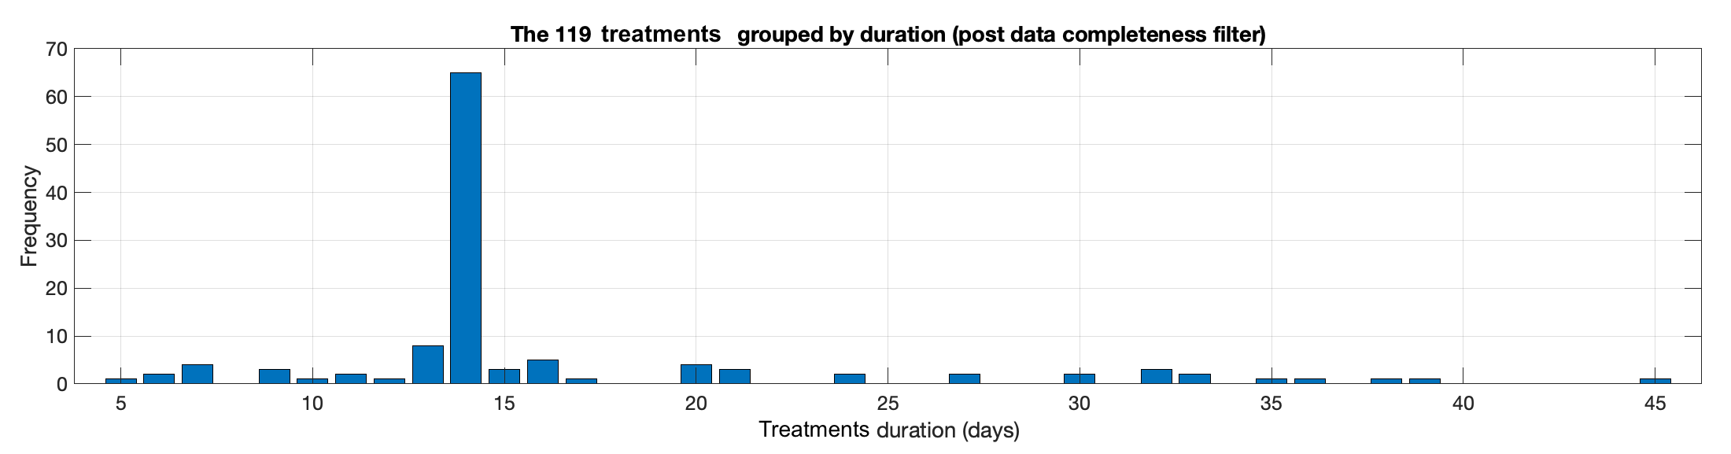
Data records length
Results
Notes:
Want to observe the behaviour during the whole treatment. At least treatment’s length + couple of days to see what happens after
High length, too few interventions due to the scarcity of the data (55 for D = 40)

Slide 30
Model dimensionality: 8
Results
8 measures studied: wellness, cough, FEV1, FEF2575, O2 saturation, pulse rate, temperature, minutes asleep
Notes:
2 points on measure selection:
Meet patient complexity with diverse number of measures
The model can be biased if one family of measures is over represented

Slide 31
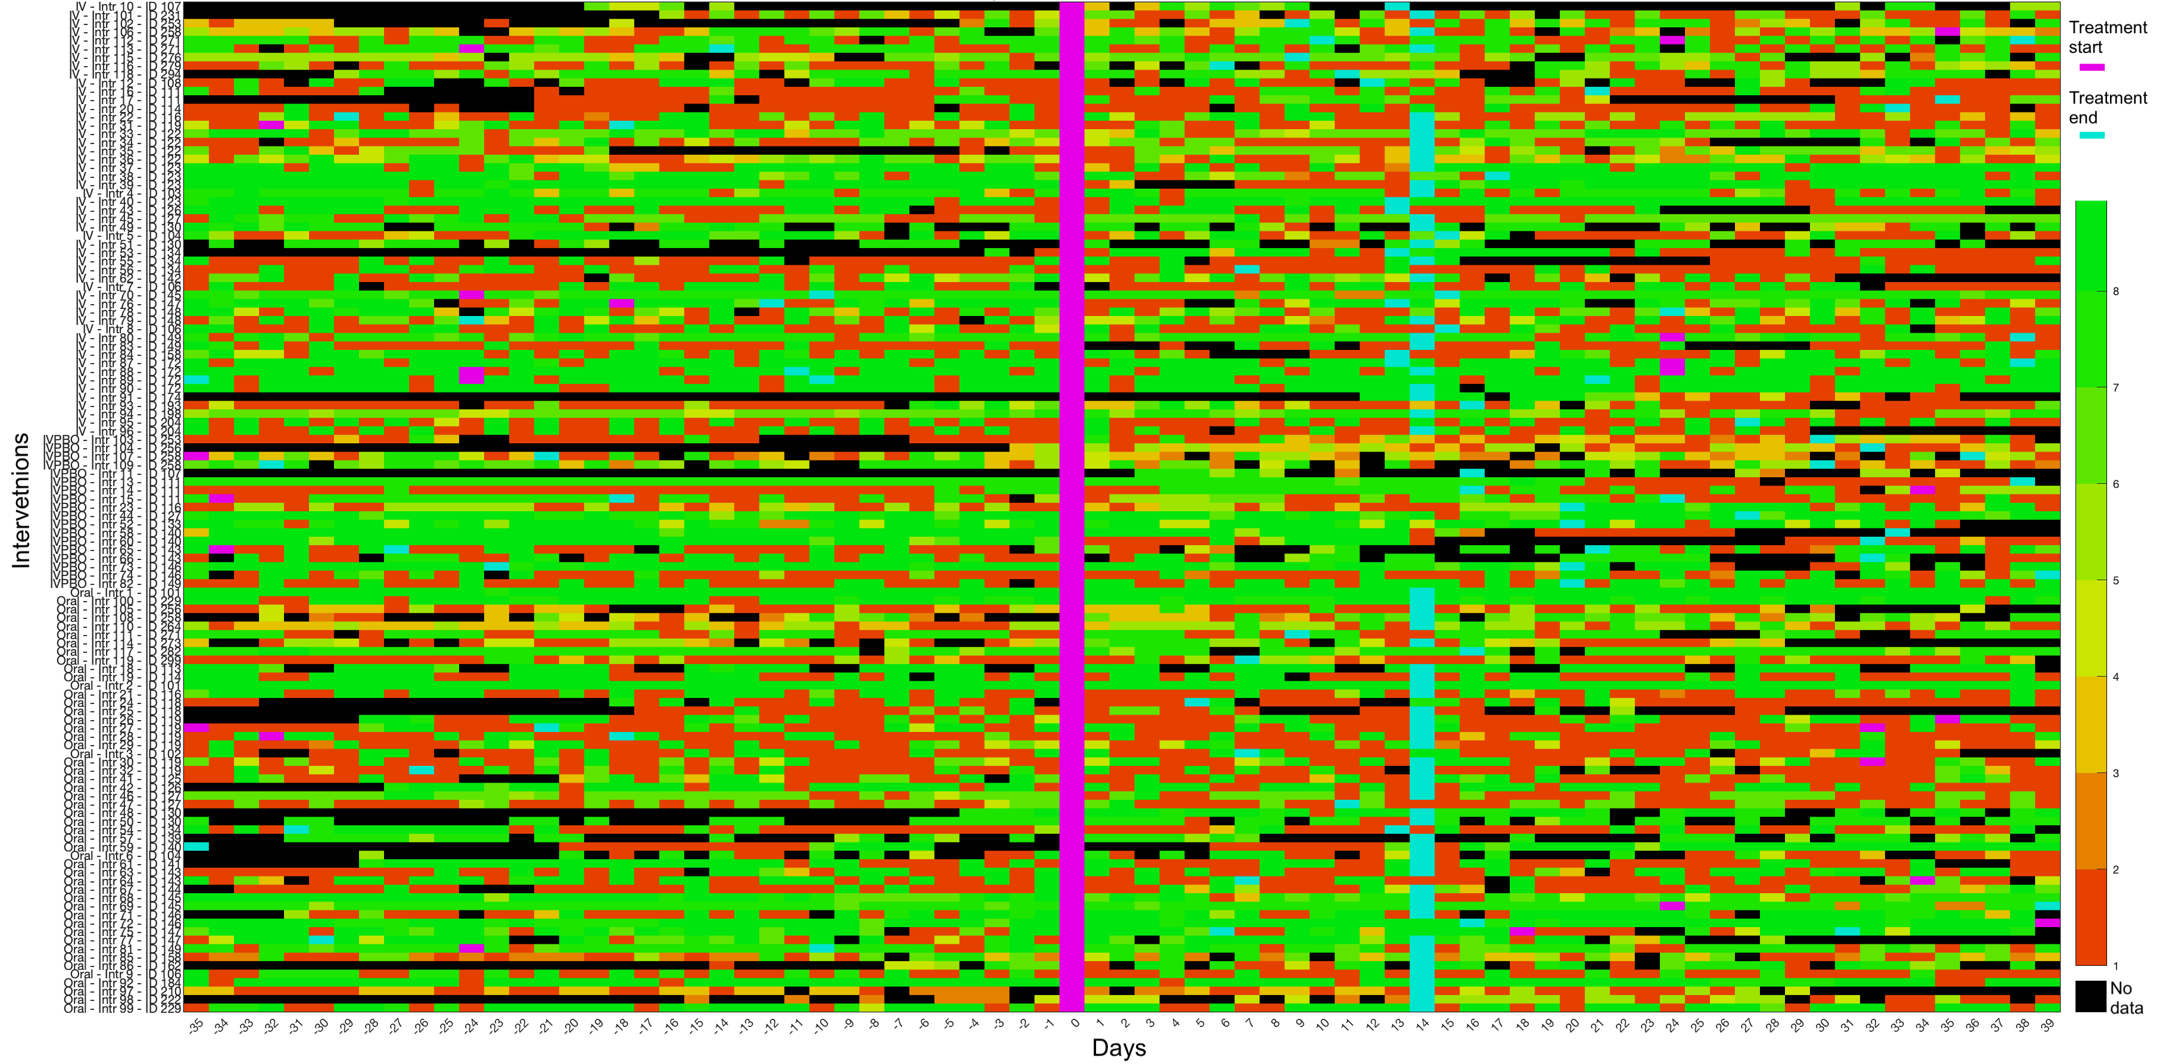
Model dimensionality: 8
Results
8 measures studied: wellness, cough, FEV1, FEF2575, O2 saturation, pulse rate, temperature, minutes asleep
Heatmap of the number of recorded measures [-35;39] days around treatment start.
Notes:
Heatmap : one rectangle = one day, its color indicate the number of measures recorded on that day. Not happy if black or red, happy if green.
Was plotted to find if there would be missing data systematically at the same moment of an intervention.

Slide 32
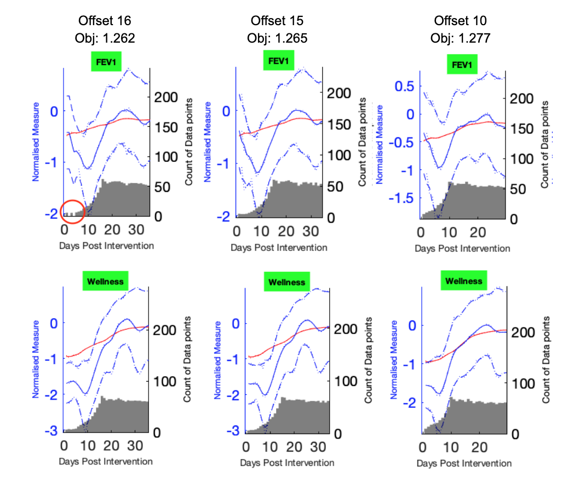
Maximum offset: 15
Results
Notes:
Min objective function
But no numerical instability

Slide 33
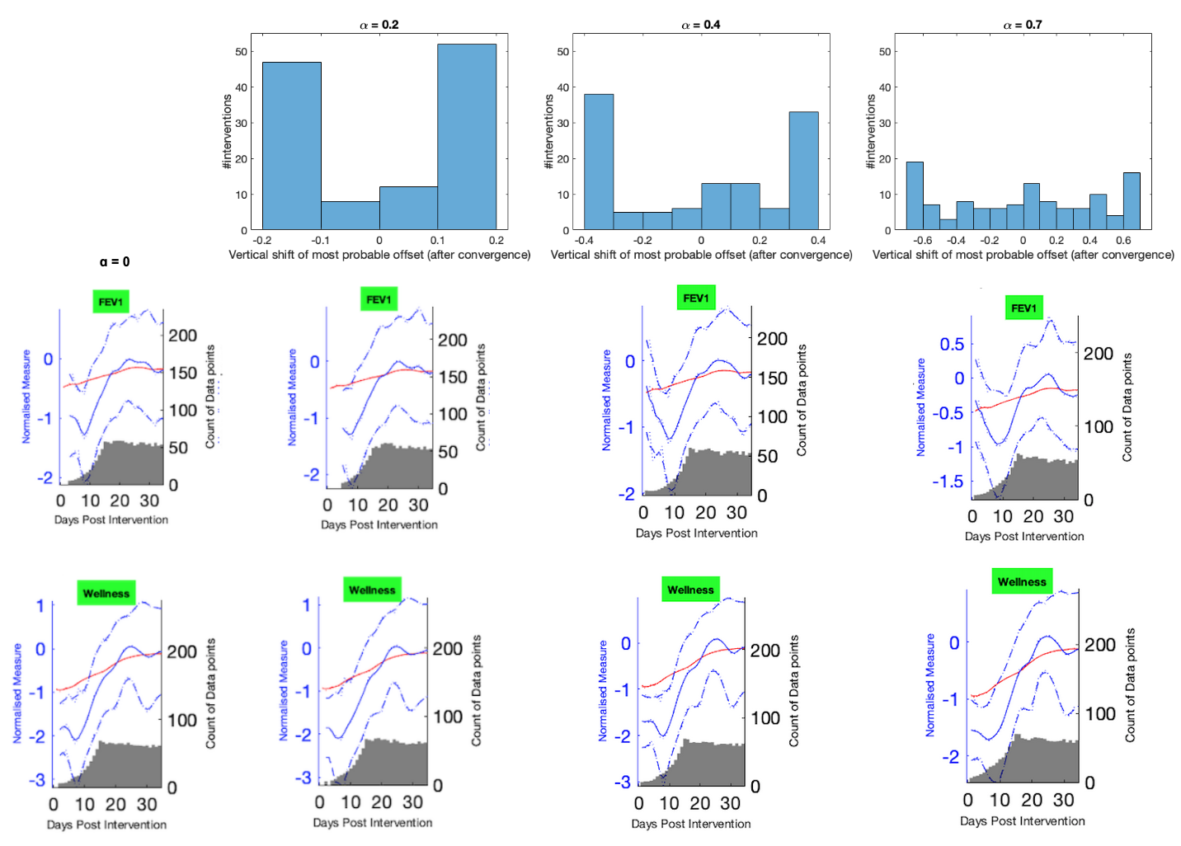
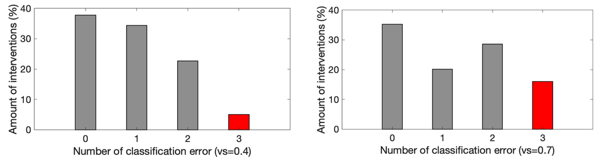
Maximum vertical shift: 0.4
Results
1 latent curve
2 latent curves
Notes:
Enough vertical shift to show the signal on the curve
If too much can’t differentiate interventions with remaining mean difference

Slide 34
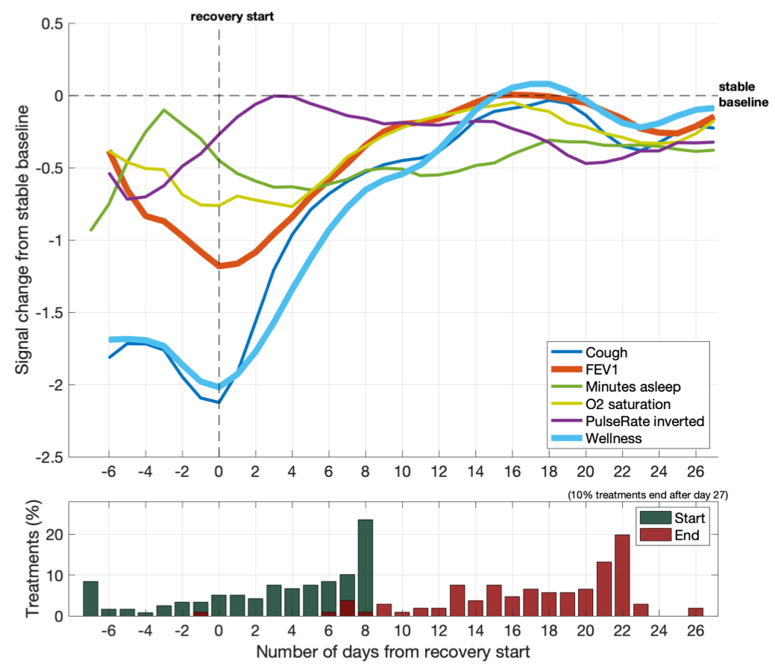
Typical profile
Results & discussion
Notes:
Set up: No vertical adjustment of the profiles. Therefore, the 0 on the y-axis corresponds to the stable baseline.
The curves were smoothed with a 3 days window to filter day to day noise and improve the clarity of the final graph.
Some left-most points are missing: there were not plotted because less than five data records’ values contribute to them, i.e. there is too much uncertainty about their typical value. The typical curve for FEF2575 and temperature were not plotted because the first it had a very close behaviour to FEV1, and the latter did not seem to contain information related to the recovery.
FEV1, cough, wellness, O2 saturation are the SIGNALS SHOWING MOST INFORMATION have a closely similar behaviour with different amplitude.
40% of the recoveries start from a full decline, 60% from a partial decline, based on FEV1, cough and wellness.
All patients’ typically recover fully 14 days after the recovery start. There is a clear recovery climax 15-20 days after treatment start. After this, the signals undergo a call-back (slight decline) prior to their stabilisation.
There is no sign of sharp decline after treatment end.

Slide 35
Typical profile
Results & discussion
Notes:
Set up: No vertical adjustment of the profiles. Therefore, the 0 on the y-axis corresponds to the stable baseline.
The curves were smoothed with a 3 days window to filter day to day noise and improve the clarity of the final graph.
Some left-most points are missing: there were not plotted because less than five data records’ values contribute to them, i.e. there is too much uncertainty about their typical value. The typical curve for FEF2575 and temperature were not plotted because the first it had a very close behaviour to FEV1, and the latter did not seem to contain information related to the recovery.
FEV1, cough, wellness, O2 saturation are the SIGNALS SHOWING MOST INFORMATION have a closely similar behaviour with different amplitude.
40% of the recoveries start from a full decline, 60% from a partial decline, based on FEV1, cough and wellness.
All patients’ typically recover fully 14 days after the recovery start. There is a clear recovery climax 15-20 days after treatment start. After this, the signals undergo a call-back (slight decline) prior to their stabilisation.
There is no sign of sharp decline after treatment end.

Slide 36
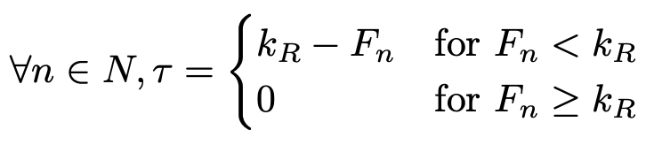
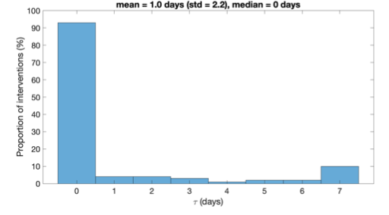
Typical time to antibiotic treatment response
Results & discussion
Recovery start - offset
Notes:
Time between treatment start and actually starting recovering.

Slide 37
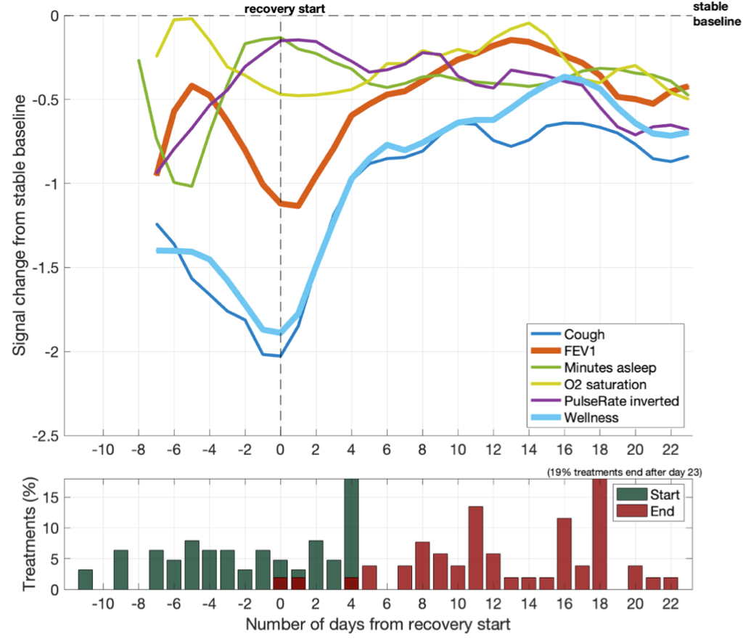
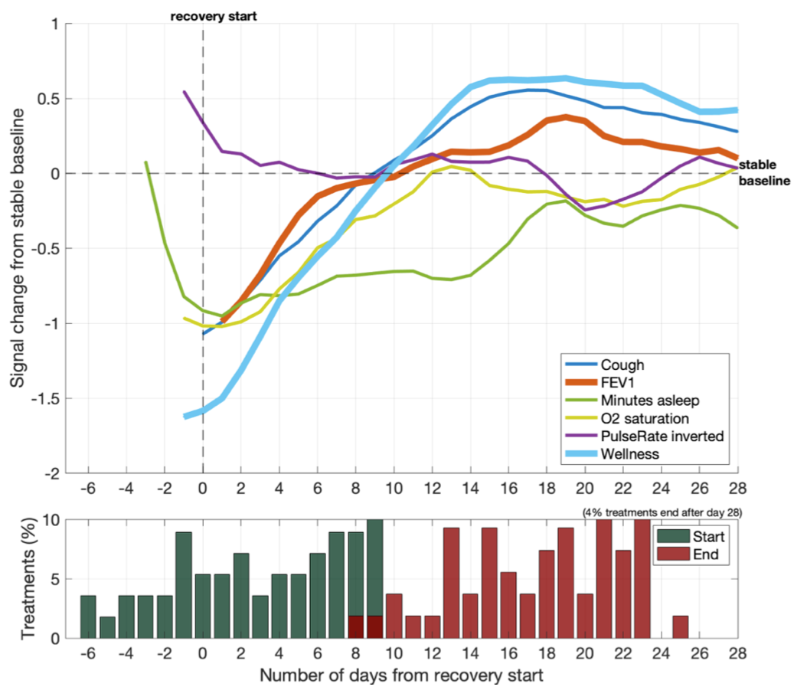
Two types of recovery inference
Results & discussion
Class 1: 53% of antibiotic interventions
Class 2: 47% of antibiotic interventions
Notes:
Class1 partial recoveries.
Class2 full recoveries with overshoot.
Difference: time to treatment response
1:
despite a clear measures’ increase after recovery start, the signals fail to recover to the stable baseline.
77% started from a full decline
presented a long time to treatment response.
2:
after an early recovery start, the measures increased sharply back to the stable baseline with a large overshoot.

Slide 38
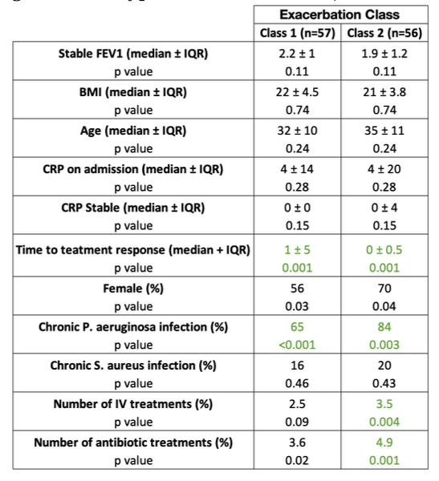
Relation with patients characteristics
Results & discussion
Notes:
Alpha 0.01
Patients with chronic pseudomonas infections were less likely to experience this kind of recovery than a class 2 recovery.
Successful recoveries correlate well with patients that were prescribed a higher number of treatments over the study period. Even though no causality effect can be concluded, it suggests that quality of a recovery from a treatment depends on the patient treatments' history.

Slide 39
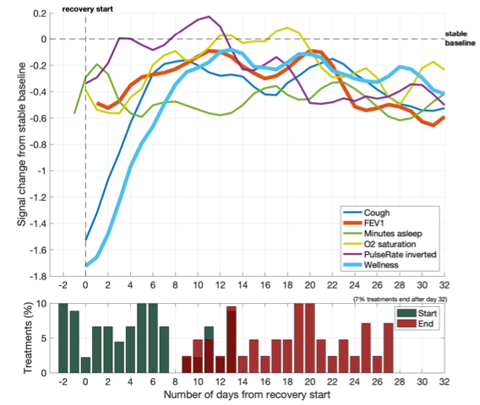
Recovery with decline
Results & discussion
30% of antibiotic interventions
Notes:
Manually selected by observation: intervention that contained a clear decline
Whereas physiological measures’ undergo a small increase at the beginning of recovery, subjective measures’ (cough and wellness) contrast by a high-sloped improve. This behaviour was not observed in any of the three other typical profiles, suggesting that it is specifically related to this kind of unsuccessful recovery.

Slide 40
Different types of recovery
Results & discussion
Recovery
Successful
Unsuccessful
No
Yes
Followed by decline?
Continuous decline or stable
Stable
Full
Partial
Treatment start
Elective treatment
Decline during APE
Full
Partial
No decline

Slide 41
Conclusion
Machine Learning can characterise:
Typical recovery profile
Different types of recoveries
Full recoveries
Partial recoveries
Recoveries with decline
Actionable information for the clinician
Patients with higher amount of treatments are more likely to experience successful recoveries. Already known, hence validates the ML approach
Prognosis of recovery quality: A high increase in subjective parameters (cough and wellness) not followed by physiological signals (FEV1, O2 saturation) can indicate the beginning of an unsuccessful recovery.
ML promise:
More data = more complex relations = more actionable items for clinicians
Model flexibility
Future work:
Analyse the impact of multiple competing features, including antibiotic choice, patient microbiology on the quality of recovery.
Infer long-term outcomes of combined treatments and therapies (in particular CFTR modulators).
Notes:
This study confirms that machine learning analysis of high frequency home monitoring data provides an opportunity to improve and personalise care for individuals with CF, through optimising hospital-based specialist management.
Additionally, given the small amount of antibiotic interventions available, the clear highlighted relations between the types of recovery and patient’s characteristics, are promising for future studies.

Slide 42
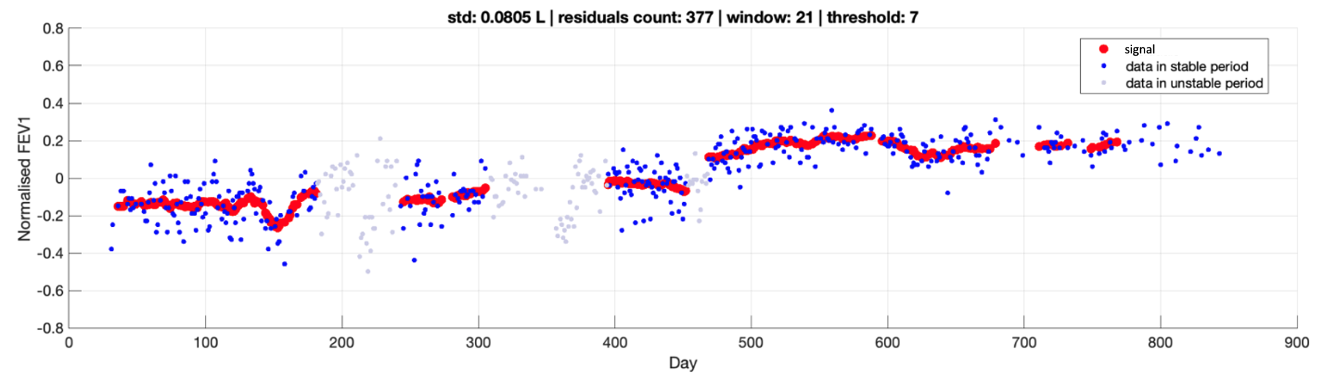
Side project: Estimation of the variability in Cystic
Fibrosis patient’s FEV1 lung function measurements

Slide 43
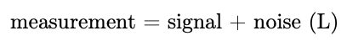
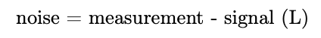
Method
FEV1 measurements
Noise
Variability
Standard deviation
Moving average filter
Signal
Notes:
Unstable period
Antibiotics treatments: -30, treatment, 15 days post treatment
CFTR modulator therapy: 15 days post therepy start

Slide 44
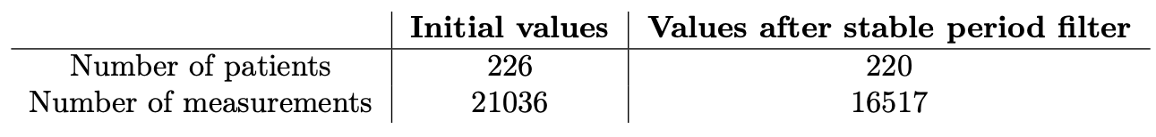
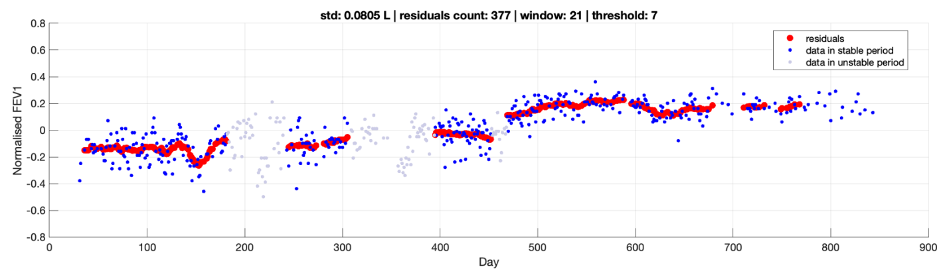
Model result
signal

Slide 45
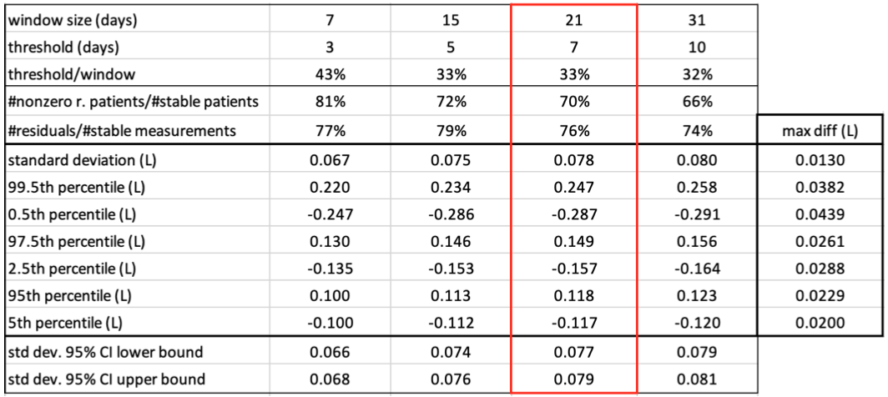
Model result
Variability: 310mL
Notes:
12500 residuals

Slide 46
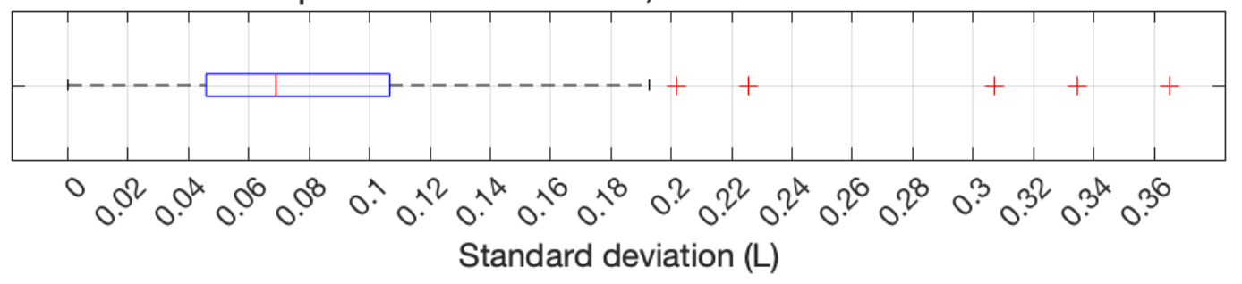
Distribution of patients’ variability
Variability is extremely diverse among patients!
Distribution of patients’ std
Median variability : 276 mL, interquartile range [184; 428] mL
Global variability: 310mL
Patient specific variability: [184; 428] mL
Notes:
Consequently, any precise study of FEV1 signal should not use a global approximation for the FEV1 variability to distinguish signal from noise, but rather a much more precise patient-specific value, which can be selected as the patient’s standard deviation of the residuals.

Slide 47
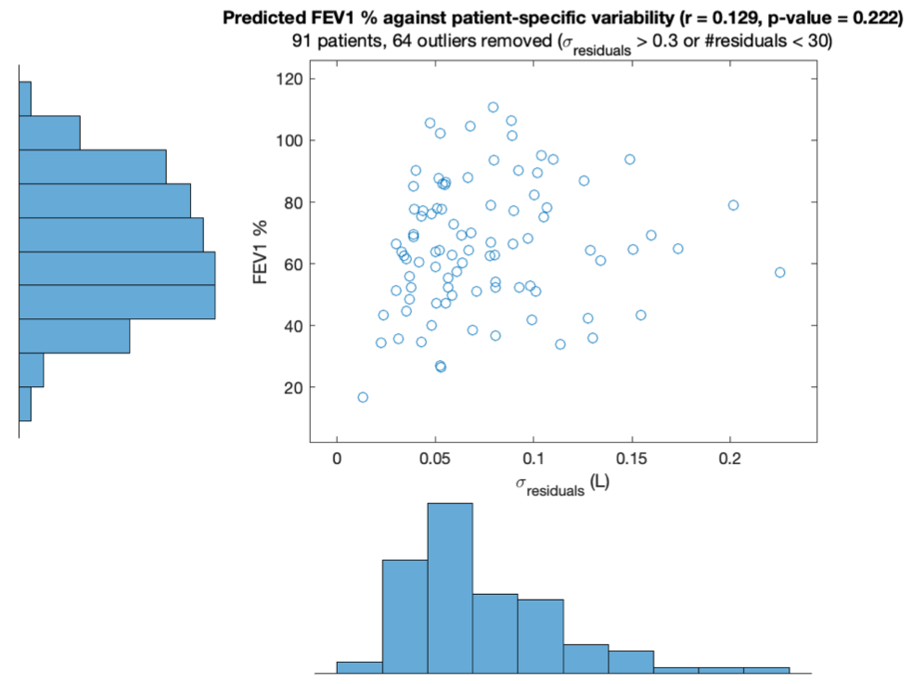
Correlation between variability and predicted FEV1%
No correlation
Notes:
Variability is explained by other factors than predicted FEV1%
Patient is tired or full of energy
Circadian rhythm
Random noise

Slide 48
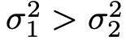
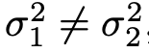
Effect on CFTR modulators
Equality of variance tests:
F-test:
Levene’s test:

Slide 49
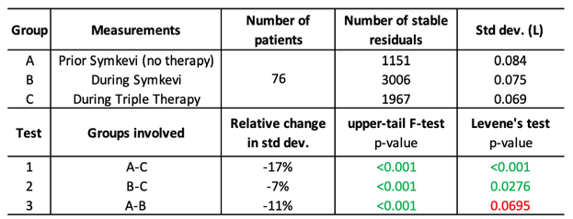
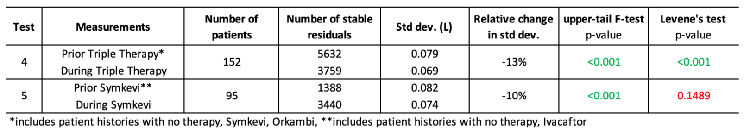
Effect on CFTR modulators
Trikafta < Symkevi
Symkevi < No therapy
Significant
Trikafta < No therapy
Not significant
Symkevi < Ivacaftor + No therapy
Trikafta < Symkevi + Ivacaftor + Orkambi + No therapy

Slide 50
Main project: Bayesian inference with Expectation Maximisation for the characterisation of antibiotic treatment recovery in Cystic Fibrosis
Side project: Estimation of the variability in Cystic
Fibrosis patient’s FEV1 lung function measurements
Thank you for your contribution!
University of Cambridge
Department of Medicine
Academic hosts
Prof. Andres Floto
Ph.D. Damian Sutcliffe
External Expert
John Winn, Machine Intelligence Group, Microsoft Research
École Polytechnique Fédérale de Lausanne
School of Engineering, School of Computer and Communication Sciences
Supervised by
Prof. Philippe Müllhaupt, School of Engineering
Prof. Martin Jaggi, Machine Learning and Optimization Laboratory
Dr. Mary-Anne Hartley, Machine Learning and Optimization Laboratory
26.08.2021

Slide 52
Without numbers
Material and methods
Imputed and and shifted interventions
N normalised antibiotic interventions
Imputed values
FEV₁
1
F₁= 0
Alignment
Imputed values
FEV₁
2
F₂
…
Max offset
…
FEV₁
N
F_{N}
D
D
Averaging
K
Antibiotic intervention start
time
FEV₁
Typical profile
M dimensions (FEV₁, wellness O₂ saturation, etc) give M typical curves
Time (days)
Notes:
Handle numerical instability

Slide 53
FEV₁
FEV₁
Alignment
FEV₁
FEV₁
FEV₁
FEV₁
Antibiotic intervention start
time
Averaging
FEV₁
time

